Slide 1
Basic Safety Measures in a Tesla Workshop
Ensuring a Safe Work environment

Slide 2

Introduction
Key Points
Importance of WorkPlace Environment
Overview of Common Hazards:
Machinery,chemicals,slips and falls.

Slide 3
Personal Protective Equipmetnt(PPE)
Essential PEE : hard gloves, goggles, ear protection, steel toed boots.
Importance of Proper fitting and Maintenance.
Training on the Correct use of PEE.

Slide 4

Machine Safety
Key Points:
Regular Inspections and maintenece of Machinery.
Use of Safety Guards and emergency buttons.
Importance of following Standard operating procedures.

Slide 5

Workplace Organisation
Key Points
Implementing 5s methodology : Sort,set in order, shine,standardize and sustain
Keeping work areas clean and organised.
Clear signage for walkways and emergency exits.

Slide 6

Training and Awareness
Key Points
Regular training sessions for all club members.
Importance of Safety drills.
Encouraging a culture of safety and open communication.

Slide 7
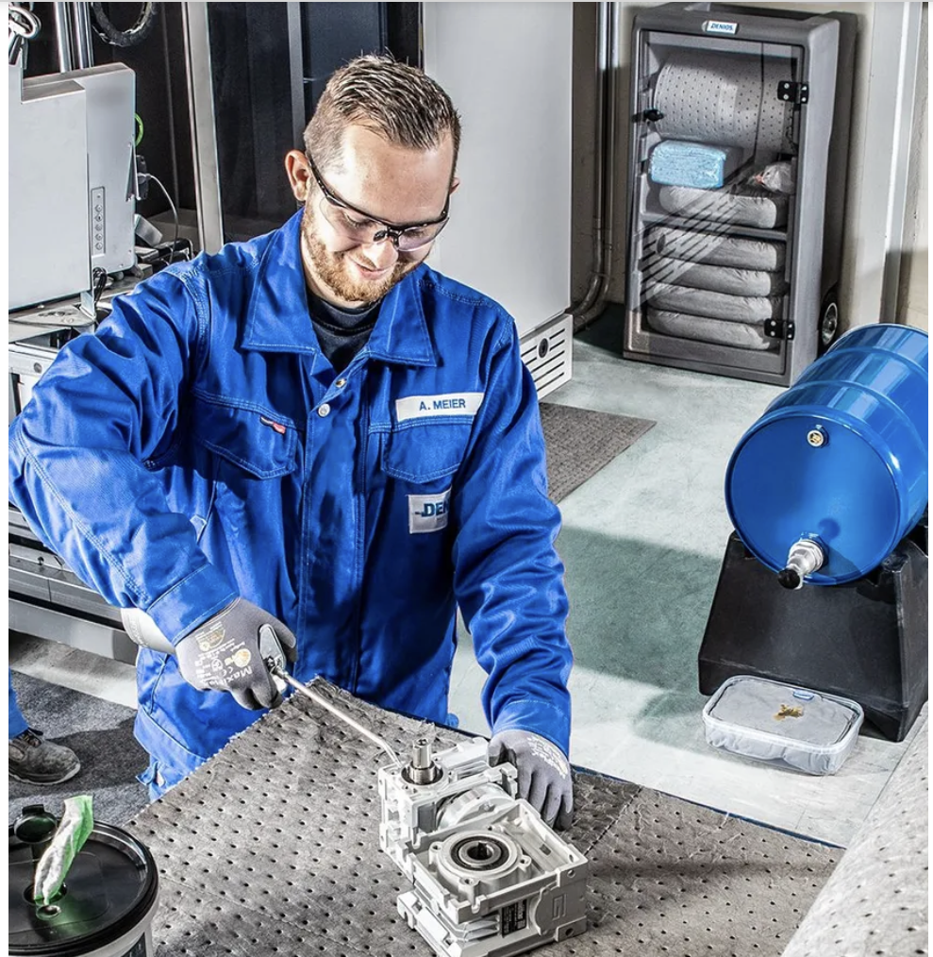
Hazardous Materials Handling
Key Points
Proper Handling and Storage of Hazardous Materials.
Use of Materials Safety data sheet.
Training on spill responses and handling procedures.

Slide 8

Emergency Procedures
Key Points
Establishing and communicating emergency response plans.
Locations of first aid kits and fire extinguishers.
Importance of having emergency contact information readily available

Slide 9
Incident Reporting and Investigation
Key Points:
Encourage immediate reporting of all accidents and near misses.
Conduct thorough investigations to identify root causes.
Implement corrective actions to prevent future incidents.

Slide 10
Call to Action: We encourage everyone to stay vigilant, speak up about safety concerns, and participate actively in our safety initiatives. Together, we can create a workplace where everyone feels secure and valued.

